Slide 1
Policy Intent Project
ENTC 689
Georgei Farouq
Rolando Alainiz
Bharath Tammi
Texas A&M University

Slide 2
Project Description
This project takes a policy PDF and a Cisco IOS configuration file, uses AI to pull out the important rules from the PDF, and then checks whether the configuration follows those rules using Python code.
The final result is an HTML report that clearly shows PASS, FAIL, or REVIEW, along with evidence for each result.

Slide 3
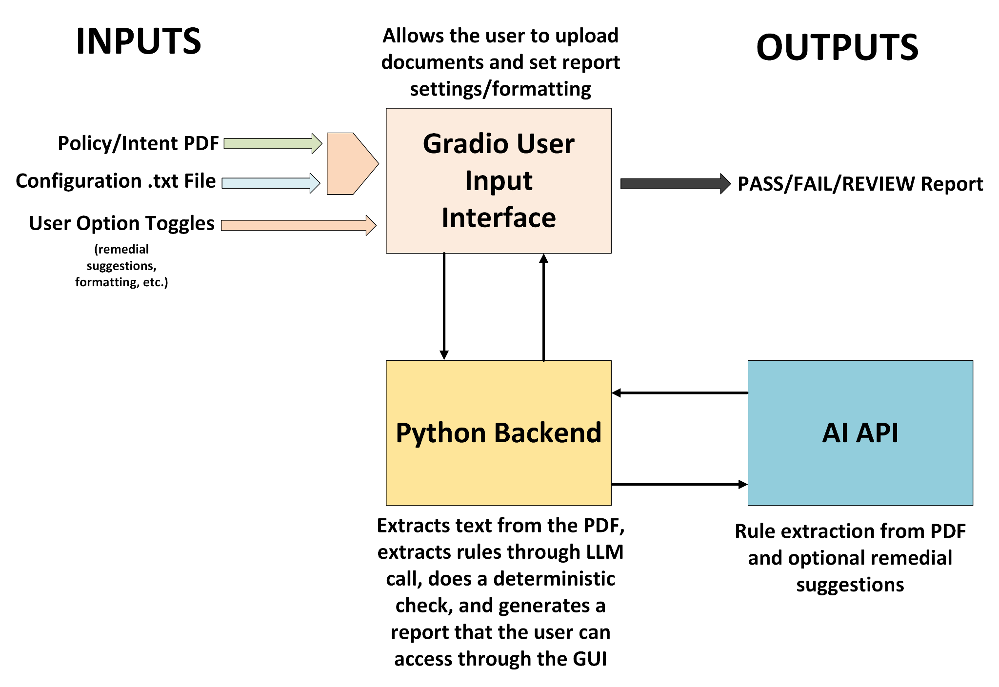
Note* AI parses the intent PDF, and creates a JSON file of rules that the python script runs a check against the .txt file with

Slide 4
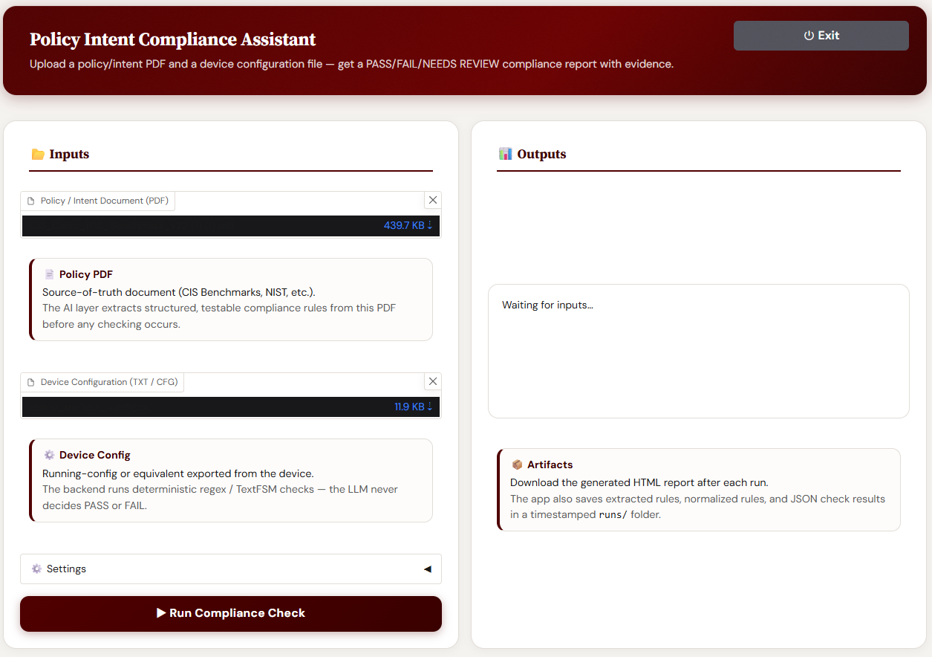
User Interface
The user interface is a local Gradio app that collects the PDF and config file, lets the user choose strictness, runs the full pipeline, and returns the final compliance report. It is the presentation and orchestration layer, not the final judge.

Slide 5
PDF Processing
Policy files are inputed into the user interface
Text is extrated from the policy files
Text is then chunked to fit required limits
Chunked data is sent to the LLM

Slide 6
Rule Extraction with LLM
Chunked data is sent to the LLM
LLM is prompted to read through the text and give a raw JSON file
Told to only create rules based on the text and not to create rules on its own
Forced to follow JSON schema
Do not duplicate near identical rulesinside one chunk
The raw JSON file needs to be adjusted to be used

Slide 7
Normalize
Clean raw LLM JSON into one consistent rule format.
Standardize fields such as scope, action, condition, and severity.
Remove duplicate or near-duplicate rules across chunks.
Resolve conflicting rules before they reach the checker.
Assign stable rule IDs and keep source references for traceability.
Output normalized rules for deterministic Python evaluation.

Slide 8
Deterministic Code Checker
Core compliance engine for Cisco IOS configs.
Evaluates normalized rules after normalize.py
Uses deterministic Python logic instead of AI.
Checks global and scoped configuration blocks.
Produces PASS, FAIL, or NEEDS HUMAN REVIEW with evidence.

Slide 9
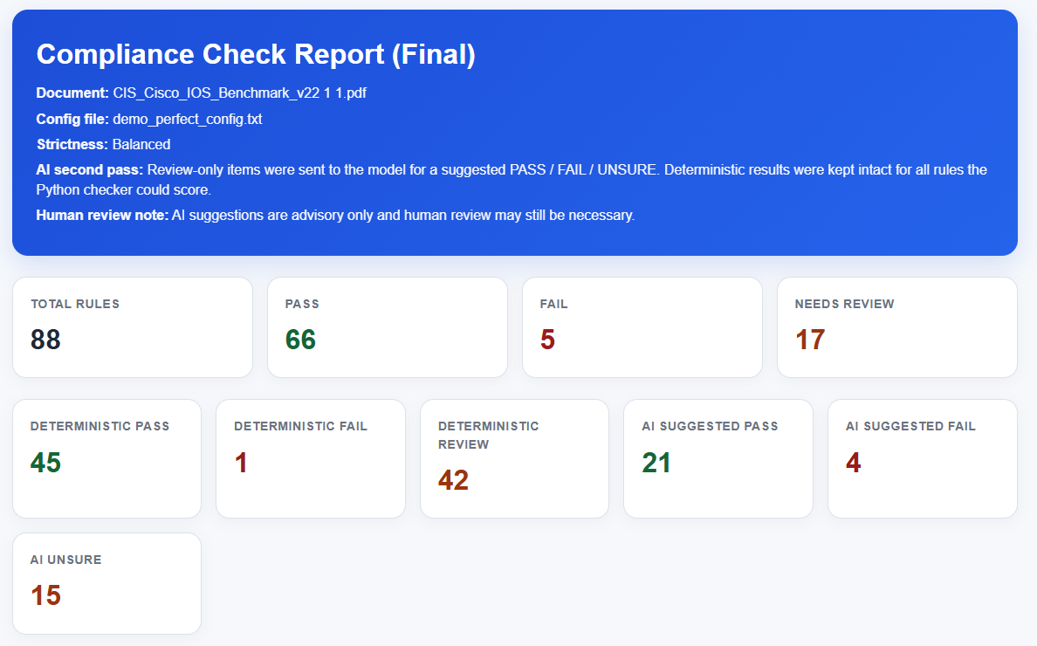
Results

Slide 10
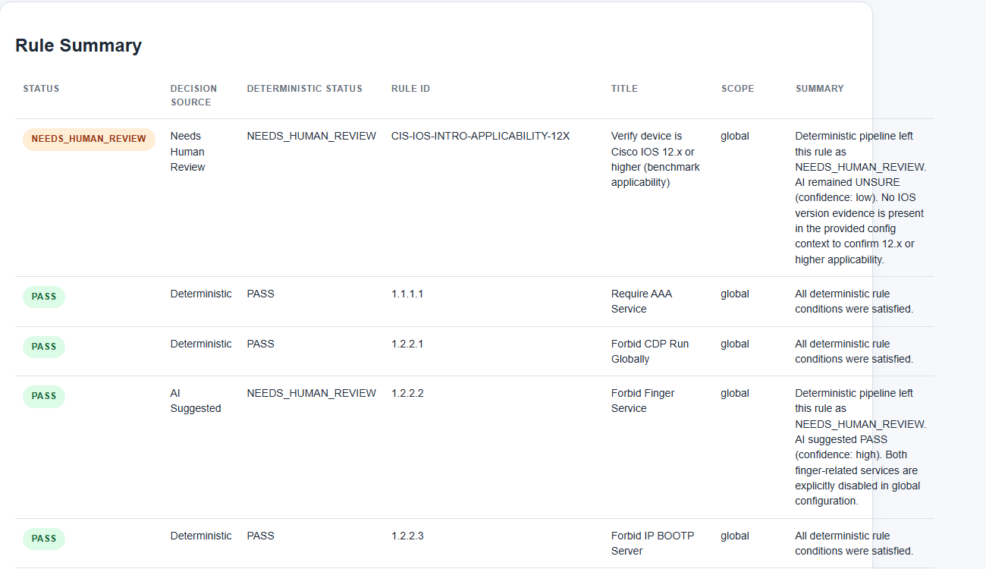
Results

Slide 11
Strengths
Explainablity
Rule number
Exact reason you got wrong
Seeing previous trials
Allows for audit trails
Debugging

Slide 12
Challenges/Limits
Currently limited to CISCO IOS
Future Work: Adding additional IOS configurations
Struggles with rule prioritization
Some rules are being falsely flagged when in reality they do not matter too much
LLM Hallucinations

Slide 13
Thank You

